Slide 1


Natural Language Processing for Qualitative Research:
A Human-Centered Approach
February 25, 2021
Christine Gregg, Nhan Le,
Michael McManus, Liu Jason Tan

Slide 2
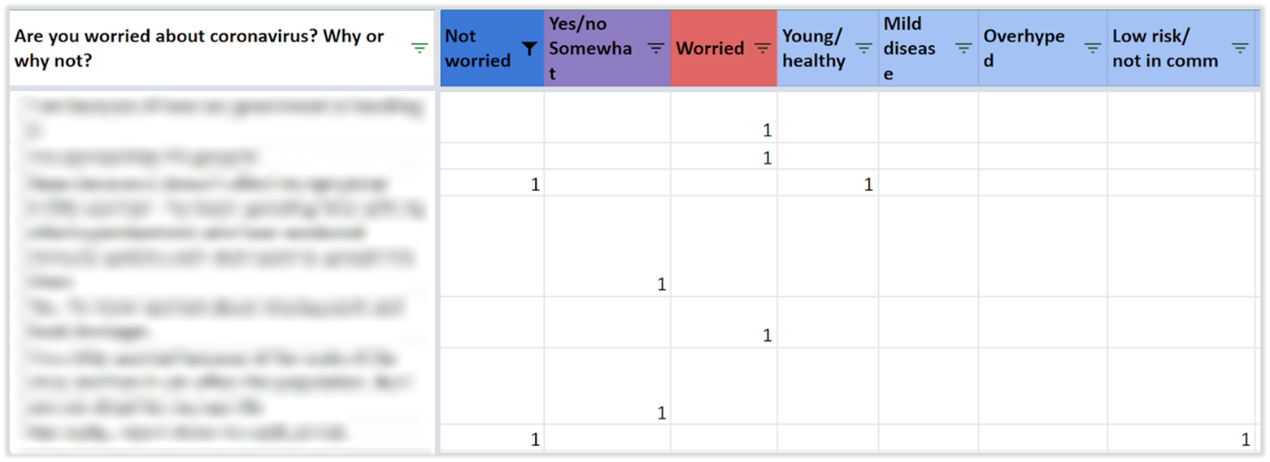

Challenge Overview
Develop an improved, NLP-enhanced qualitative research process to quickly extract insights from MyVoice text message polling data.
Excel screenshot provided by MyVoice Data Challenge hosts during initial information session on December 9, 2020. Image modified to remove participant information.
Notes:
Add talking point – only analyzed COVID dataset

Slide 3




Project Goals
Human Centered
Rapid & Efficient
Nuance Friendly
Reproducible
The process must be easy for researchers to understand and use
The process must enable faster qualitative coding
The process must allow researchers to choose the level of granularity
The process must document its steps to support validation
Notes:
Nuance friendly – treating the subjects as humans by stitching together their story through reviewing subtle changes in themes over time

Slide 4
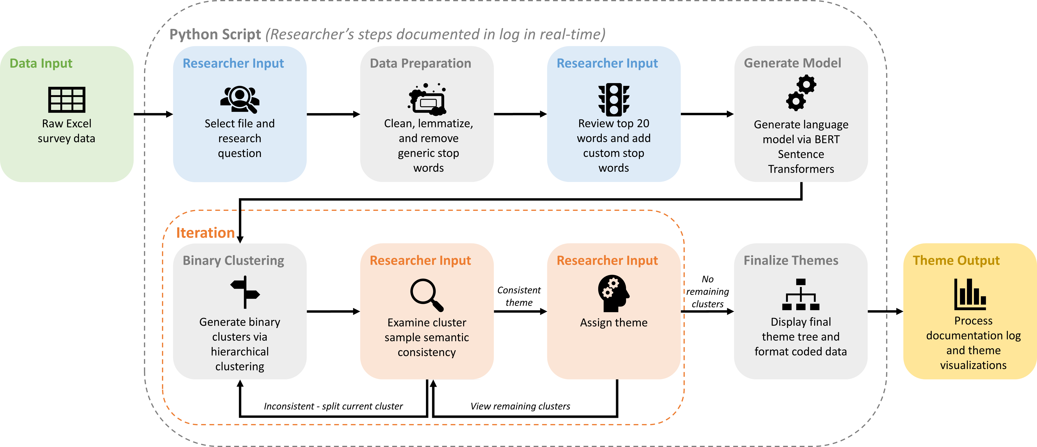
Process Overview
Notes:
BERT selected because of best apparent fit to the data, but the code is written to allow plug-and-play of different language models

Slide 5
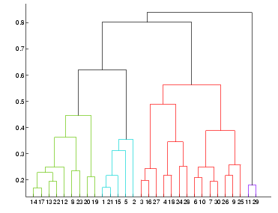








Walkthrough | BERT Language Model
Google’s BERT model is a pre-trained neural network
Text encoding with sentence transformers
Model utilizes hierarchical (agglomerative) clustering to split clusters
This Photo by Unknown Author is licensed under CC BY-SA

Slide 6
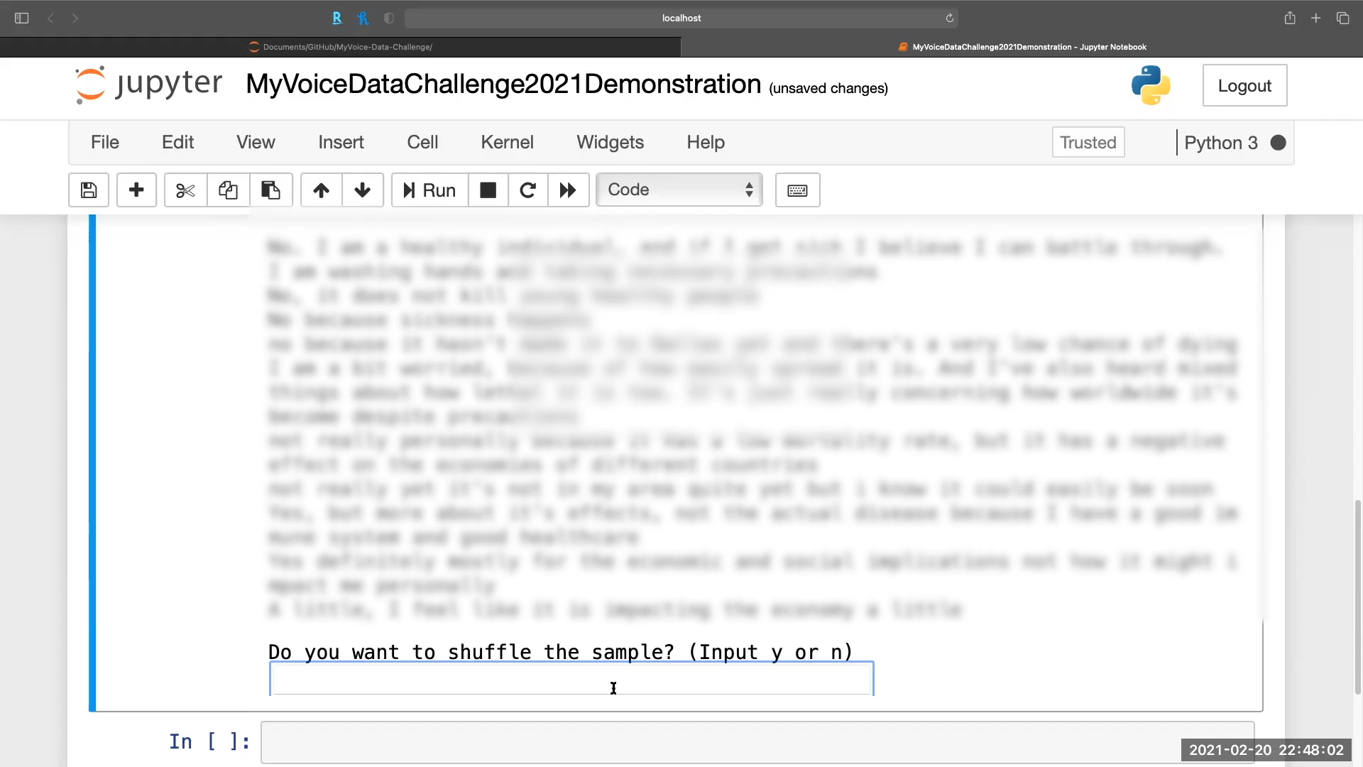



Walkthrough | Review & Split Cluster

Slide 7
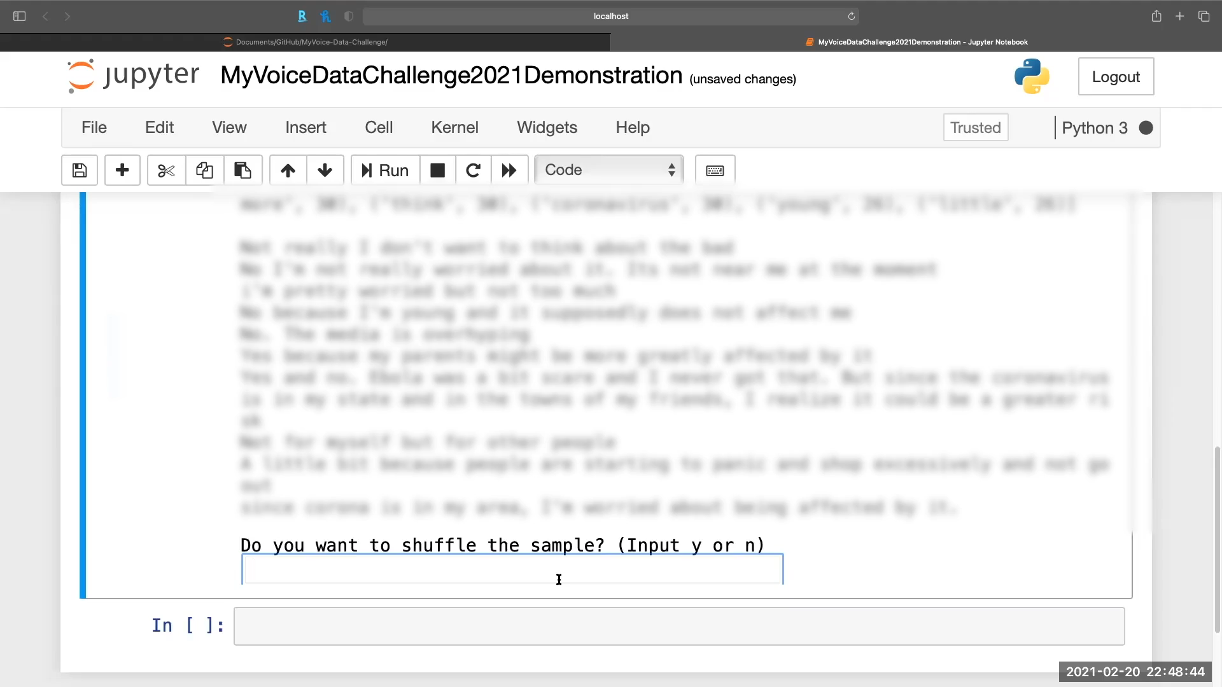

Walkthrough | Review & Name Cluster

Slide 8
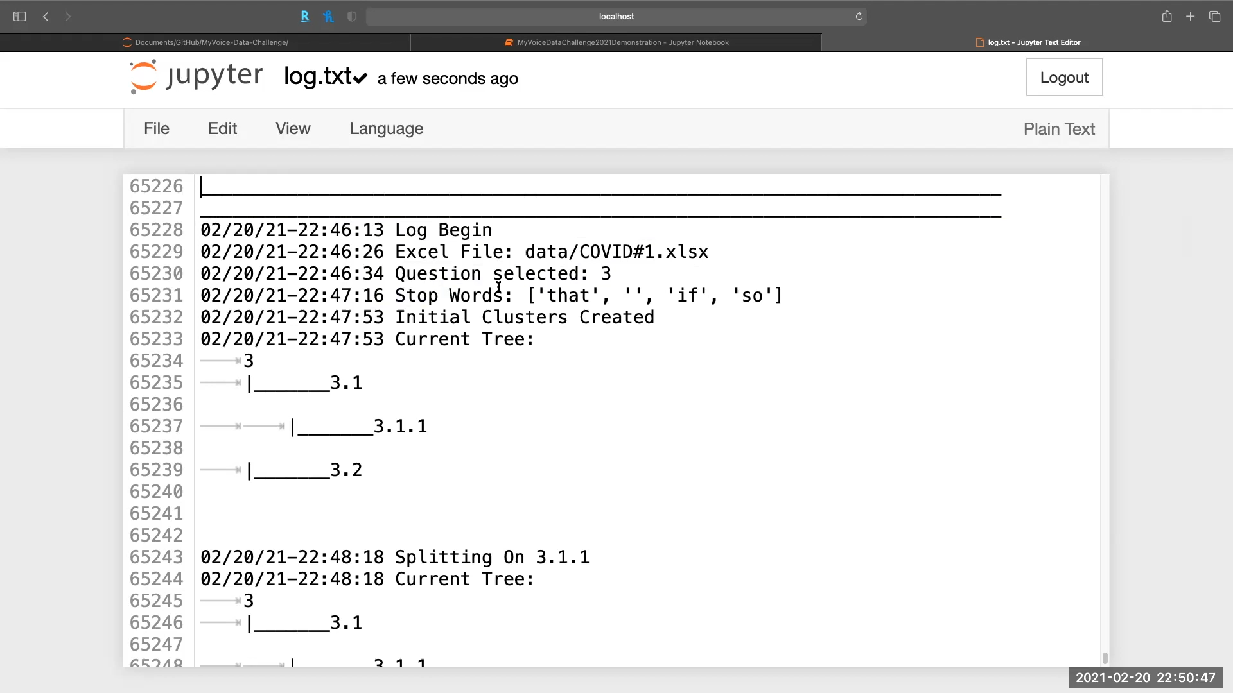

Walkthrough | Display Final Log

Slide 9
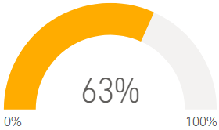
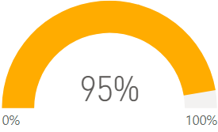
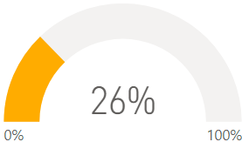
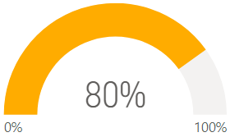
Results Summary | Trial #1
General Sentiment | March 6, 2020 | March 20, 2020
Impacted by COVID-19*
Worried by COVID-19
+32%
+54%
*The follow-up survey question about COVID-19 impacts on March 20, 2020 was worded differently than the original March 6 question, which may have influenced the results.
Notes:
Mike’s Results

Slide 10
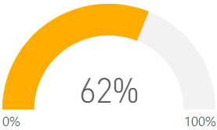
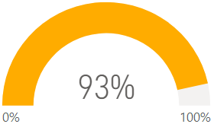
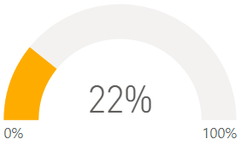
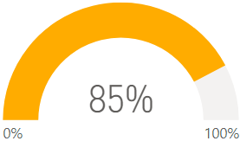
Results Summary | Trial #2
General Sentiment | March 6, 2020 | March 20, 2020
Impacted by COVID-19*
Worried by COVID-19
+31%
+63%
*The follow-up survey question about COVID-19 impacts on March 20, 2020 was worded differently than the original March 6 question, which may have influenced the results.
Notes:
Nhan’s Results

Slide 11
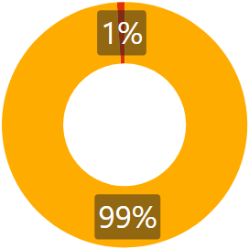
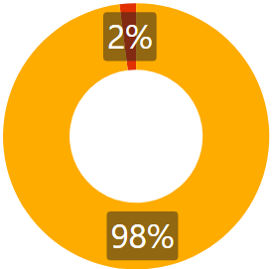
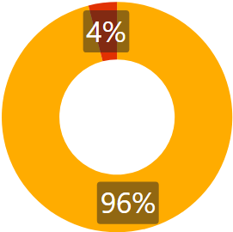
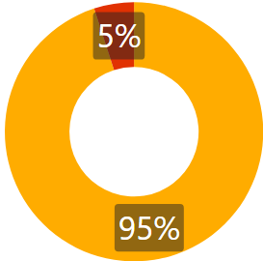
Results Summary | Trial Comparison
Sentiment Across Trials | March 6, 2020 | March 20, 2020
Impacted by COVID-19
Worried by COVID-19
Notes:
Mike’s Results vs Nhan’s Results

Slide 12
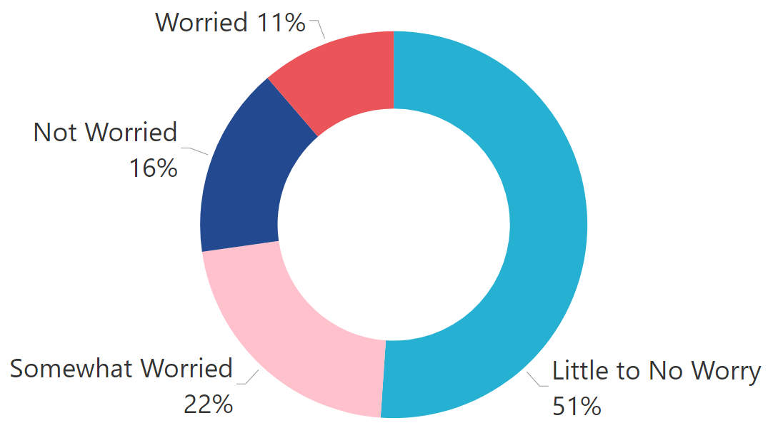
Results Summary | Detailed Themes
Are you worried about coronavirus? Why or why not?
3/6/2020

Slide 13
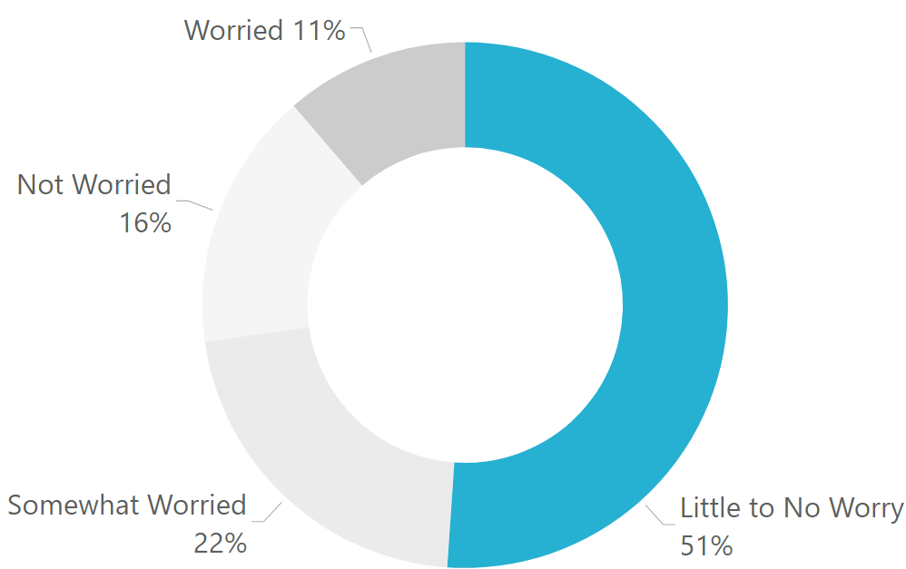
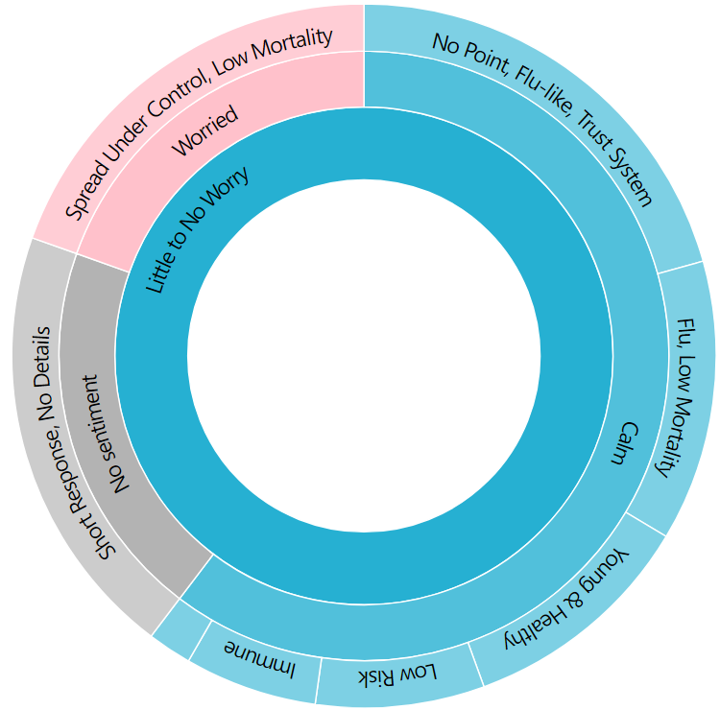

Results Summary | Detailed Themes
Are you worried about coronavirus? Why or why not?
3/6/2020

Slide 14



Process Limitations
Program
Human
Slang and abbreviations
Duplicate themes
Suggestions
Incorporate subject matter labeling standards
Quality of result hinges on quality of theme names and keywords
Error may vary considerably by research question
Additional step to consolidate similar themes
Test alternate pre-trained BERT models
Create GUI
Notes:
Input:
Relies on Manual Preprocessing / Data Cleaning:
Currently relies on preprocessing and cleaning of data prior to exploration. For the purpose of this project, we chose to focus on computer aided coding as this seemed to be the biggest contribution we could provide. By automating the cleaning of data, time cost would be further reduced. Future iterations would benefit from automating this step.
Thematic Naming:
Shuffling may not show all values -- may miss minority opinion during random sampling; possibility to get a particularly noisy sample.
Theme naming can create its own clustering challenge in itself if the researcher isn’t consistent with theirs or their colleagues naming convention or themes.
In its current state, the tool provided would be best utilized if a naming convention for clusters is discussed and agreed upon by coders prior to exploration.
Unsupervised Learning:
Current model is based on an Unsupervised Learning approach utilizing pretrained models. Using more data that was previously coded by the researchers to train a Supervised Model may yield better results.
Could benefit from a GUI: Creating a graphical user interface would help in further time cost reduction and help with the aesthetic. A sample prototype will be provided in subsequent slide.
Output:
Error Rate Quantification / Visualization:
Theme outputs require a bit of work before they’re ready for visualization
Difficult to quantify error rate - objective vs subjective aspects of a question’s themes
Imperfect Clustering:
Shuffling may not show all values -- may miss minority opinion during random sampling; possibility to get a particularly noisy sample.
Theming functionality is great in as much as the model will provide clusters with overarching similarities. The hard part is you may have one person say “Yes, I’m worried because the government isn’t doing a good job.” and another who says “No, I’m not worried because the government is doing a good job.”. As humans we recognize both individuals are speaking about the government, but we recognize these as different reactions. The overall theme coded here would be “government” but each underlying sentiment is contradictory. The model will pick these out but it requires the researcher to go several cluster branches deep.
Unlikely to perform at same level for more complex questions -- more testing/data is required
Above distilled from original notes below:
Needs human input -- I personally think this is a pro (CG) -- could be both? (LJT) -- This is necessary and not really a limitation in my mind (MSM)
Clustering not perfect -- wind up with lots of clusters that need to be distilled down
Shuffling may not show all values -- may miss minority opinion during random sampling; possibility to get a particularly noisy sample
Aesthetics -- interface is definitely in “beta” and could use significant polishing
Theme naming can create its own NLP challenge in itself if the researcher isn’t consistent
Theme outputs require a bit of work before they’re ready for visualization
Unlikely to perform at same level for more complex questions -- more testing/data is required
Difficult to quantify error rate - objective vs subjective aspects of a question’s themes
Based on an Unsupervised Learning approach utilizing pretrained models. Using more data that was previously coded by the researchers to train a Supervised Model may yield better results.
In its current state, the tool provided would be best utilized if a naming convention for clusters is discussed and agreed upon by coders prior to exploration.
Although considerable time savings are present in the tool’s current state, exploration can still be time consuming. Creating a graphical user interface would help in further time cost reduction.
Currently relies on preprocessing and cleaning of data prior to exploration. For the purpose of this project, we chose to focus on computer aided coding as this seemed to be the biggest contribution we could provide. By automating the cleaning of data, time cost would be further reduced.
Theming functionality is great in as much as the model will provide clusters with overarching similarities. The hard part is you may have one person say “Yes, I’m worried because the government isn’t doing a good job.” and another who says “No, I’m not worried because the government is doing a good job.”. As humans we recognize both individuals are speaking about the government, but we recognize these as different reactions. The overall theme coded here would be “government” but each underlying sentiment is contradictory.

Slide 15
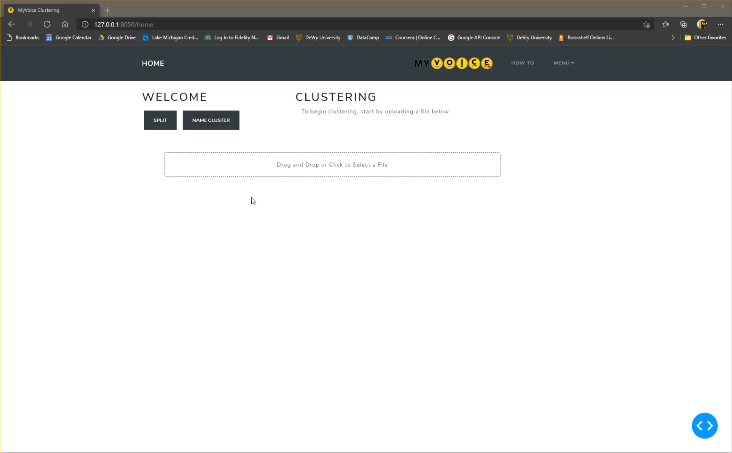
Proposed GUI

Slide 16



Impact on Future Research
Improved Scalability
Greater Flexibility
Deeper Understanding
Process more responses and ask more questions
A soft framework puts the researcher in control
Detailed themes put sentiments in their contexts

Slide 17
Thank You
Christine Gregg | cgregg@umich.edu
Nhan Le | nhanle@umich.edu
Michael McManus | msmcmanu@umich.edu
Liu Jason Tan | liuta@umich.edu

Slide 18
Process Overview
Notes:
BERT selected because of best apparent fit to the data, but the code is written to allow plug-and-play of different language models

Slide 19
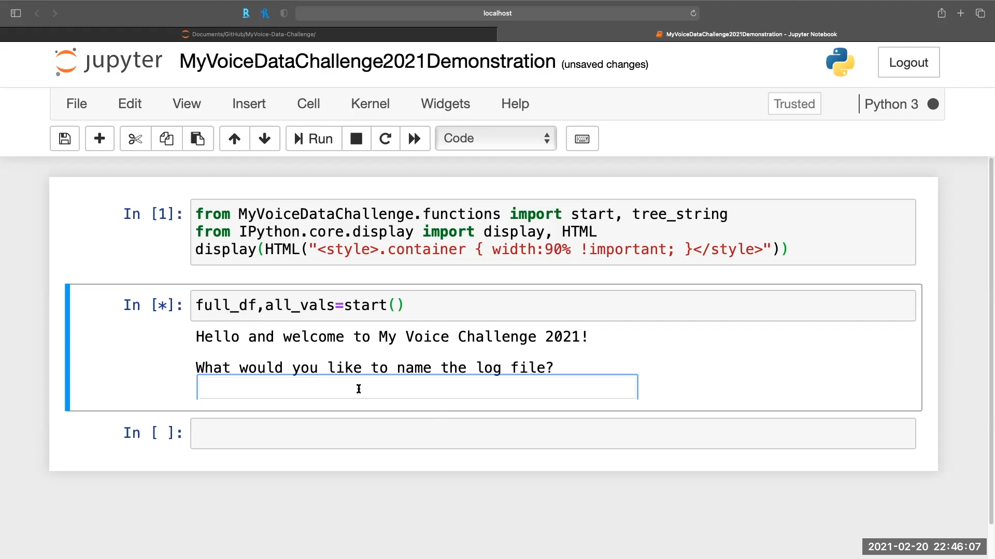

Walkthrough | File Selection

Slide 20
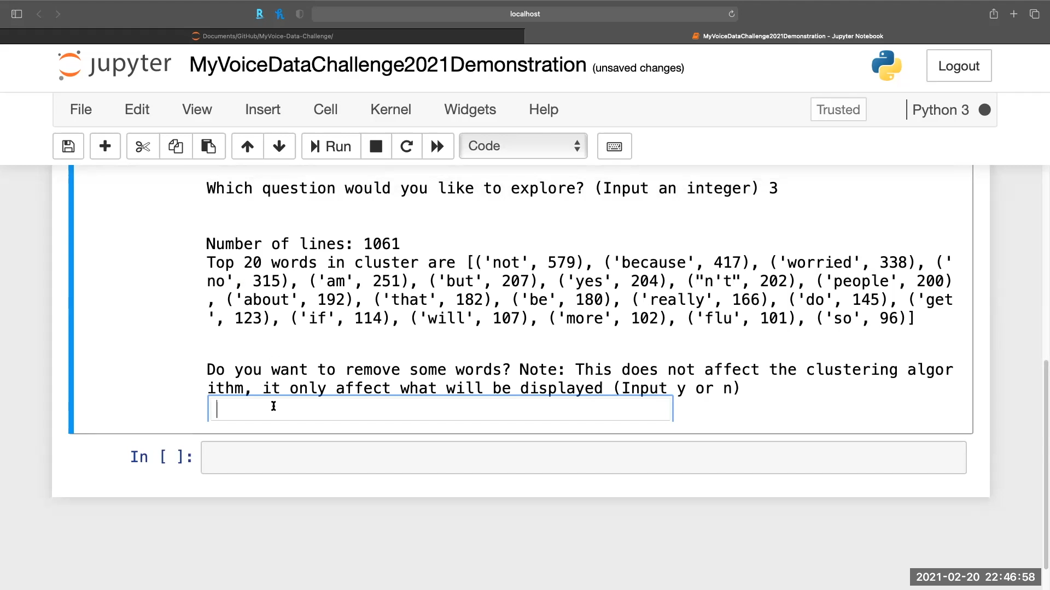

Walkthrough | Remove Stop Words

